Slide 1
Why to Learn AI and Machine Learning? (Machine Learning in Python)

Slide 2
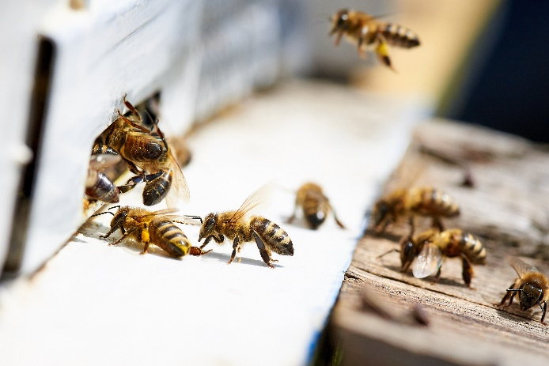
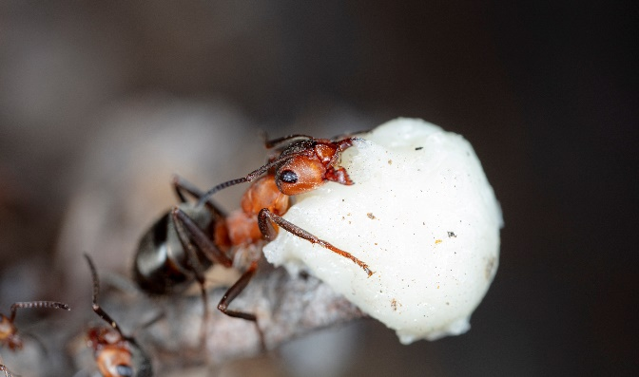
Why to Learn Artificial Intelligence?
1.) OPTIMIZATION ALGORITHMS
determinsitic algorithms are working fine usually such as graph algorithms
or other optimization algorithms (dynamic programming etc.)
BUT THEY ARE GETTING EXTREMELY SLOW AS
THE SEARCH SPACE INCREASES !!!
there are heuristic and meta-heuristic
approaches to deal with this problem
genetic algorithms, ant colony optimization
bee colony optimization etc.

Slide 3


Why to Learn Artificial Intelligence?
2.) ROBOTICS
An interesting problem is how to navigate and move robots in an unknown
environment (such as exploration robots on Mars)
we need shortest path algorithms to navigate
the exploration robot as efficient as possible
graph algorithms are useful such as A* search

Slide 4
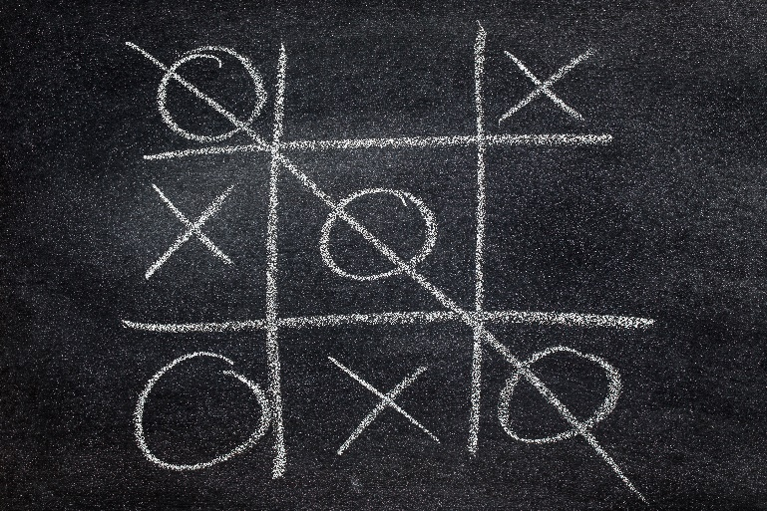

Why to Learn Artificial Intelligence?
3.) GAMES
We can use artificial intelligence and machine learning to construct perfect
or nearly-perfect players for games (such as chess or tic-tac-toe)
minimax algorithm that used depth-first
search and recursion to find the
optimal next move
alpha-beta pruning method

Slide 5
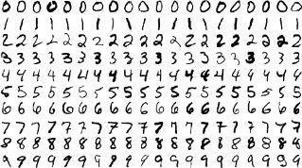

Why to Learn Artificial Intelligence?
4.) NEURAL NETWORKS AND DEEP LEARNING
Neural networks, machine learning and deep learning are in the center of
artificial intelligence (of course becasue these approaches are working fine)
handwritten digit classification
face detection algorithms and face
recognition algorithms
natural language processing (NLP) and
sentiment analysis (text clustering)

Slide 6

Why to Learn Artificial Intelligence?
5.) REINFORCEMENT LEARNING
Reinforcement learning has several applications (self-driving cars) but
the most interesting one is related to games
it is the state of the art approach to deal
with 2 player games
→ chess and AlphaGo etc.

Slide 7
Types of Learning (Machine Learning in Python)

Slide 8
Types of Learning
There are 3 main types of learning in artificial intelligence
– SUPERVISED LEARNING –
we have a dataset with the labels for the machine learning algorithm

Slide 9
Types of Learning
There are 3 main types of learning in artificial intelligence
– SUPERVISED LEARNING –
we have a dataset with the labels for the machine learning algorithm
– UNSUPERVISED LEARNING –
we have just the dataset and the machine learning algorithm finds the relationships present in the data

Slide 10
Types of Learning
There are 3 main types of learning in artificial intelligence
– SUPERVISED LEARNING –
we have a dataset with the labels for the machine learning algorithm
– UNSUPERVISED LEARNING –
we have just the dataset and the machine learning algorithm finds the relationships present in the data
– REINFORCEMENT LEARNING –
there is no dataset at all and the machine learning algorithms interact with the environment to learn

Slide 11
Types of Learning
SUPERVISED LEARNING
We have a dataset with samples and labels as well. Most of the
machine learning techniques rely heavily on datasets
WE GIVE THE ALGORITHM THE RIGHT ANSWERS !!!
During the training procedure:
→ the input is the features (x,y)
→ the output is the x XOR y label
The aim is to make sure that the prediction made
by the algorithm is approximately the same
as the label in the dataset
x
y
x XOR y
0
0
0
0
1
1
1
0
1
1
1
0

Slide 12
Types of Learning
SUPERVISED LEARNING
We have a dataset with samples and labels as well. Most of the
machine learning techniques rely heavily on datasets
WE GIVE THE ALGORITHM THE RIGHT ANSWERS !!!
During the training procedure:
→ the algorithm will find out what is the
difference between the two classes
x₂
x₁

Slide 13
Types of Learning
SUPERVISED LEARNING
We have a dataset with samples and labels as well. Most of the
machine learning techniques rely heavily on datasets
WE GIVE THE ALGORITHM THE RIGHT ANSWERS !!!
During the training procedure:
→ the algorithm will find out what is the
difference between the two classes
x₂
this is the so-called decision boundary
that defines the separation
between the classes
x₁

Slide 14
Types of Learning
UNSUPERVISED LEARNING
We have a dataset without labels. The algorithm itself will
find patterns in the unlabeled dataset (such as clustering algorithms)
WE DO NOT GIVE THE ALGORITHM THE RIGHT ANSWERS !!!
During the training procedure:
→ the algorithm will find the most relevant
features to make the classification
x₂
x₁

Slide 15
Types of Learning
UNSUPERVISED LEARNING
We have a dataset without labels. The algorithm itself will
find patterns in the unlabeled dataset (such as clustering algorithms)
WE DO NOT GIVE THE ALGORITHM THE RIGHT ANSWERS !!!
During the training procedure:
→ the algorithm will find the most relevant
features to make the classification
x₂
x₁

Slide 16
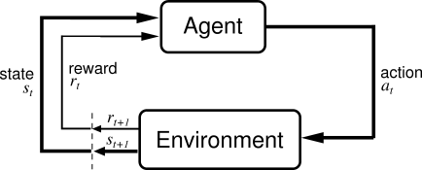
Types of Learning
REINFORCEMENT LEARNING
In this case we do not have a dataset at all. The artificial intelligence agent
interacts with the environment (states) and figures out what to do (action)
UPON DOING ACTIONS THE AGENT RECEIVES A REWARD/PENALTY !!!
finding the shortest path – there are states (cells) and
actions (we can visit the neighbor cells)

Slide 17
Types of Learning
REINFORCEMENT LEARNING
reinforced learning can be used to learn
playing tic-tac-toe game
environment are the cells on the board
the agent (computer player) makes a move
according to the board states
move is the location of the X
eventually the game will end: agent will receive
reward (win) or receive penalty (lose)
0
X
0
X
The computer (agent) initially plays poorly but after the training procedure (so playing a lot)
it will be able to choose the right actions and moves

Slide 18
Linear Regression (Machine Learning in Python)

Slide 19
Linear Regression
Linear regression is an approach for modelling the relationship between
scalar dependent variable y and one or more explanatory variables x
SIMPLE LINEAR REGRESSION
single explanatory variable x
we want to approximate the price
of houses if we know the size

Slide 20
Linear Regression
Linear regression is an approach for modelling the relationship between
scalar dependent variable y and one or more explanatory variables x
SIMPLE LINEAR REGRESSION
single explanatory variable x
we want to approximate the price
of houses if we know the size
MULTIPLE LINEAR REGRESSION
several explanatory variables x
we want to approximate the price of
houses if we know the sizes and
the number of rooms etc.

Slide 21
Linear Regression
WHAT IS THE AIM OF LINEAR REGRESSION?
want to find some linear relationship
between the features
prices [$]
500
400
x is the independent variable we use to
make predictions (size of house)
300
H(x) = b₀ + b₁ x
200
H(x) is the dependent variable that we
are trying to predict or estimate
(price of the house)
100
size of houses [m²]
30
50
80
100

Slide 22
Linear Regression
So we build a model based on the dataset
→ it is a linear model so the
result is a linear line
→ the model defines the relationship
between the variables
→ we can make predictions with the
trained model
What does it mean? If we have a new x feature
(size of the house) we can get the H(x) price
of the house accordingly
prices [$]
500
400
300
200
100
size of houses [m²]
30
50
80
100

Slide 23
Linear Regression
we have a dataset (all machine learning algorithm needs one)

Slide 24
Linear Regression
we have a dataset (all machine learning algorithm needs one)
we train the model which means finding the linear relationship
between the H(x) and x variables

Slide 25
Linear Regression
we have a dataset (all machine learning algorithm needs one)
we train the model which means finding the linear relationship
between the H(x) and x variables
H(x) = b₀ + b₁ x
OPTIMIZATION !!!

Slide 26
Linear Regression
we have a dataset (all machine learning algorithm needs one)
we train the model which means finding the linear relationship
between the H(x) and x variables
H(x) = b₀ + b₁ x
OPTIMIZATION !!!
after the training we have the b values which means
we can make predictions with the model for new datapoints

Slide 27
Linear Regression
we have a dataset (all machine learning algorithm needs one)
we train the model which means finding the linear relationship
between the H(x) and x variables
H(x) = b₀ + b₁ x
OPTIMIZATION !!!
after the training we have the b values which means
we can make predictions with the model for new datapoints

Slide 28
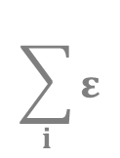
Linear Regression
Mean Squared Error (MSE)
it is the difference between the y labels present in the
dataset (supervised learning) and the H(x) values
predicted by the model
ε₇
ε₉
ε₄
ε₆
ε₈
ε₁
ε₃
ε₅
[ H(x) – y ]²
„cost-function”
ε₂
if this term is small (small error): it means the model
predictions are very close to the actual values
$$\sum_{i}{ε}$$
MSE =
2
i
if this term is large (large error): it means the model
predictions differ from the actual values

Slide 29
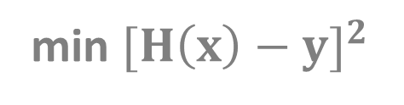
Linear Regression
OPTIMIZATION PROBLEM
this is why optimization algorithms are so important
no matter what problems we are dealing with finally we have to use
some optimization methods to solve it
H(x) is the prediction from
our linear model (linear regression)
min ${[H\left(x\right)−y]}^{2}$
OPTIMIZATION !!!
b
we want to find the minimum
by tuning these parameters
y is the value we know from
the training data

Slide 30
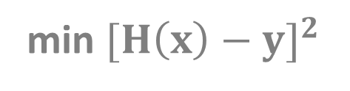
Linear Regression
https://onlinecourses.science.psu.edu/stat501/node/382
OPTIMIZATION PROBLEM
this is why optimization algorithms are so important
no matter what problems we are dealing with finally we have to use
some optimization methods to solve it
DESIGN MATRIX APPROACH (linear algebra)
We can transform the problem into linear equations and
use the standard method (using matrix operations)
min ${[H\left(x\right)−y]}^{2}$
-1
b = (X’X) X’ y
b
GRADIENT DESCENT
It is a first-order iterative optimization algorithm
for finding the minimum of a function

Slide 31
Linear Regression
DESIGN MATRIX APPROACH
it is the best approach
for low-dimensional problems
low dimension means few features
if the matrix is large then the
matrix operations are expensive
in higher dimensions
matrix inversion takes O(N³)
usually there are large number
of feautres
GRADIENT DESCENT
this is an iterative
approach
this algorithm works fine
even in high dimensions
(large number of features)
THIS APPROACH IS PREFERRED !!!

Slide 32
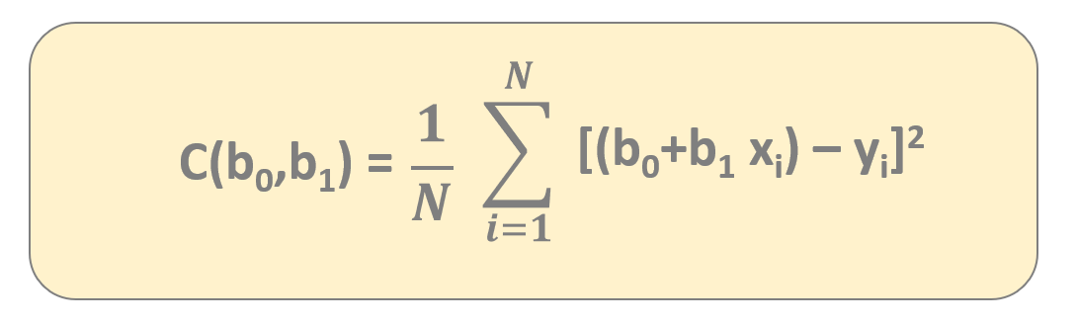
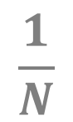
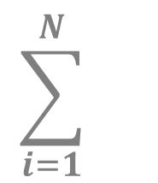
Gradient Descent
$$\sum_{i=1}^{N}{}$$
$$\frac{1}{N}$$
[(b₀+b₁ x_{i}) – y_{i}]²
C(b₀,b₁) =
we can express the C(b₀,b₁) cost-function
because this is the formula we need fr gradient descent

Slide 33
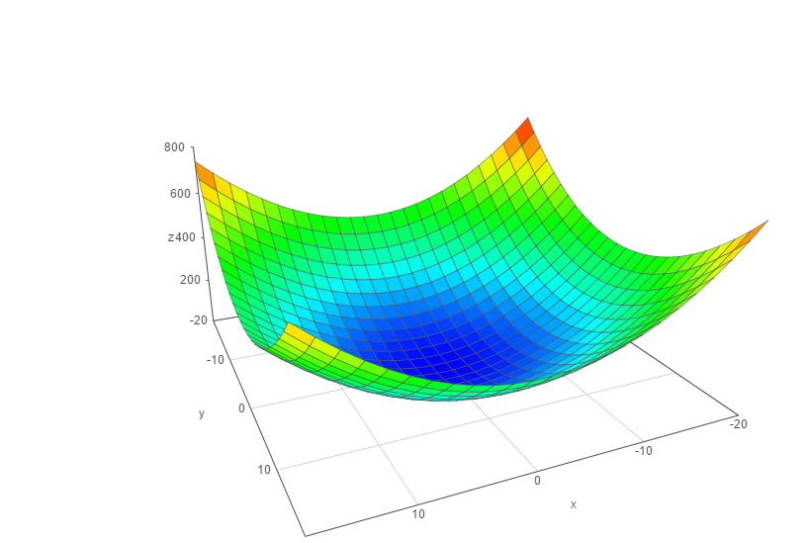
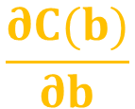
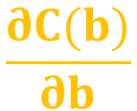
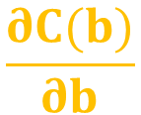

Gradient Descent
We have to know the partial derivative of the C(b) cost function
and go to the direction of the gradient (partial derivative)
C(b)
$$\frac{∂C(b)}{∂b}$$
$$\frac{∂C(b)}{∂b}$$
0
1
the f(x) gradient of a given f(x) function
is pointing in the direction of maximum
Δ
we are after the minimum so we have to use
- f(x) instead (negative gradient)
b
Δ
1
b
make iterations {
}
0
$$\frac{∂C(b)}{∂b}$$
$$\frac{∂C(b)}{∂b}$$
b ← b – α
b ← b – α
0
0
1
1
0
1

Slide 34
Gradient Descent
α: learning-rate
→ small learning-rate: the algorithm takes small
steps towards the minimum and it takes
more time to converge
→ large learning-rate: the algorithm takes big
steps towards the minimum so the algorithm
is faster but not as accurate
C(b)
b
1
b
0

Slide 35
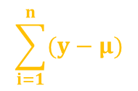
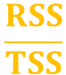

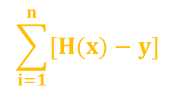
Linear Regression Parameters
2
The R statistic is defined as follows:
2
$$\frac{RSS}{TSS}$$
the higher the better the model fits the data
R = 1 -
measures the accuracy of the regression models
It is the square of the correlation coefficient r
~ so it measures how strong of a linear relationship is
between two variables !!!
RSS - „residual sum of squares”
Measures the variability left unexplained after performing the regression
TSS - „total sum of squares”
It measure the total variance in y
$$\sum_{i=1}^{n}{[H(x)−y]}$$
2
$$\frac{1}{n}$$
$$\sum_{i=1}^{n}{(y−μ)}$$
2

Slide 36
Logistic Regression (Machine Learning in Python)

Slide 37
Logistic Regression
Linear regression solves the problem of regression which means the
result is a scalar value (such as the price of a house)
LOGISTIC REGRESSION SOLVES THE
PROBLEM OF CLASSIFICATION !!!
→ usually we use logistic regression for binary classification
and the output is dicrete (0 or 1)
→ problems such as spam detection for emails, predicting if a customer will
default on a loan (credit scoring problem)
it assigns probabilities to given outcomes so the output is a probability
that the given input belongs to a certain class

Slide 38
Logistic Regression
Applying linear regression for classification problems is not a good idea
we want to deal with probabilities as well
paying back
the debt
it is sensitive to outliers (the model changes dramatically)
it has values outside the [0,1] range and we are after
a binary classification with 2 possible outcomes
1 (YES)
0 (NO)
balance on
credit card
300
500
800
1000

Slide 39
Logistic Regression
Applying linear regression for classification problems is not a good idea
we want to deal with probabilities as well
paying back
the debt
it is sensitive to outliers (the model changes dramatically)
it has values outside the [0,1] range and we are after
a binary classification with 2 possible outcomes
1 (YES)
0 (NO)
balance on
credit card
300
500
800
1000

Slide 40
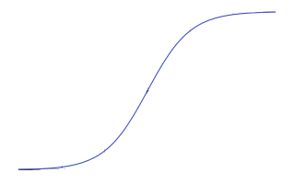
Logistic Regression
Applying linear regression for classification problems is not a good idea
we want to deal with probabilities as well
paying back
the debt
it is sensitive to outliers (the model changes dramatically)
it has values outside the [0,1] range and we are after
a binary classification with 2 possible outcomes
1 (YES)
1
f(x) =
1 + e
-x
this is the so-called logistic function
that has the features we have discussed earlier
0 (NO)
balance on
credit card
300
500
800
1000

Slide 41
Logistic Regression
1
this is the so-called logistic function
that has values in the range [0,1]
f(x) =
1 + e
-x
we are able to solve the problems we have discussed in the
previous lectures and slides
it has a value between [0,1] so it can be interpreted as probability
this logistic function is not sensitive to outliars

Slide 42
Logistic Regression
So instead of a linear model we have to deal with the sigmoid-function
1
p(x) =
1 + e
- (b + b * x)
0
1
the probability of default given x balance
p(x) = P(y=1|x=balance)
these are the model parameters b₀ and b₁
there are several ways to fit the model
→ gradient descent
→ maximum-likelihood method

Slide 43
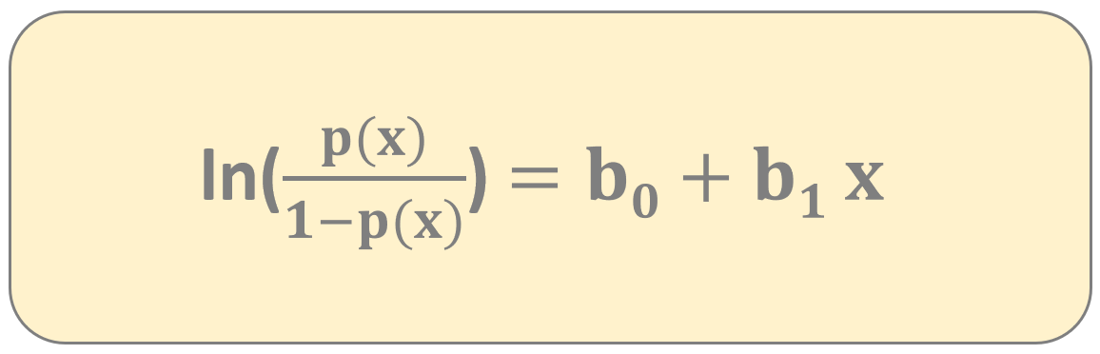
Logistic Regression
So instead of a linear model we have to deal with the sigmoid-function
„logit transformation”
the point of the logit transformation is to make it linear – so logistic regression
is a linear regression on the logit transformation
we can fit the b parameters with gradient descent and maximum-likelihood method
Logistic regression is a generalized linear model not because the estimated probability
of the response is linear but because the logit of the estimated
probability response is a linear function of the parameters

Slide 44
Logistic Regression
SIMPLE LOGISTIC REGRESSION MULTINOMIAL LOGISTIC REGRESSION
we have just a single x parameter
for example balance on credit card
we have multiple x parameters
for example balance on credit card, age,
gender, demographics, loan to income ratio etc.
1
1
p(x) =
p(x) =
- (b + b * x)
1 + e
- (b + b * x + ... + b x )
1 + e
0
1
0
1
1
n
n
Usually we use logistic regression for binary classification so with 2 output classes
for example email classification (spam or not) or a client is sick or healthy ...

Slide 45
Logistic Regression
Maximum likelihood estimation is a method of estimating the parameters of a
statistical model given observations by finding the parameter values that
maximize the likelihood of making the observations given the parameters
l(β,x) = ln L(β,x)
this is the log
likelihood-function
this is the
likelihood-function
The aim is the same as we have seen for linear regression so we are after the
optimal b values that maximizes the likelihood-function
b such that arg max l(β,x)
b

Slide 46
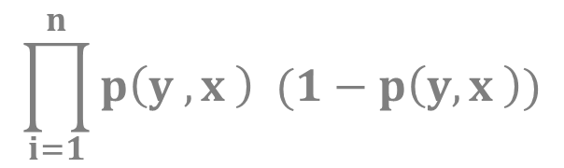
Logistic Regression
Maximum likelihood estimation is a method of estimating the parameters of a
statistical model given observations by finding the parameter values that
maximize the likelihood of making the observations given the parameters
$$\prod_{i=1}^{n}{p\left(y ,x \right) (1−p\left(y,x \right))}$$
y
1-y
L(β) =
i
i
i
i
i
i
likelihood-function for
logistic regression
1
p(y ,x ) =
i
i
1 + e
- (x’ * b )
i
this estimate is usually obtained by using the
iterative Newton-Raphson method

Slide 47
Cross Validation (Machine Learning in Python)

Slide 48
Cross Validation
TRAINING DATASET
TEST DATASET
~ 70% of the original dataset
~ 30% of the original dataset
We fit the model to the training dataset then we test the model on the test dataset
We only have information how the model performs to our in-sample data
but we would like to see the accuracy when dealing with new data
OVERFITTING model has trained „too well” on the training dataset
→ it means it is very accurate on the training dataset but yields
poor results on the test set (due to too complex models)
→ the model learns the „noise” instead of the actual relationships
between the variables in the data (of course this noise
is not present in the test set...)
x
2
x
1

Slide 49
Cross Validation
TRAINING DATASET
TEST DATASET
~ 70% of the original dataset
~ 30% of the original dataset
We fit the model to the training dataset then we test the model on the test dataset
We only have information how the model performs to our in-sample data
but we would like to see the accuracy when dealing with new data
UNDERFITTING model has not been fitted well to the training dataset
→ misses the trends in the training dataset
→ this is usually the case when we use too
simple models for the problem
x
2
x
1

Slide 50
Cross Validation
K-FOLDS CROSS VALIDATION
helps to avoid underfitting as well as overfitting (by the way it helps
to avoid overfitting more than underfitting)
the aim is to be able to generalize the model to new datasets with same accuracy
we use all the data for training (no need to split the original dataset)

Slide 51
Cross Validation
K-FOLDS CROSS VALIDATION
helps to avoid underfitting as well as overfitting (by the way it helps
to avoid overfitting more than underfitting)
the aim is to be able to generalize the model to new datasets with same accuracy
we use all the data for training (no need to split the original dataset)
DATASET

Slide 52
Cross Validation
K-FOLDS CROSS VALIDATION
helps to avoid underfitting as well as overfitting (by the way it helps
to avoid overfitting more than underfitting)
the aim is to be able to generalize the model to new datasets with same accuracy
we use all the data for training (no need to split the original dataset)
split the data into k folds
(for example k=5)

Slide 53
Cross Validation
K-FOLDS CROSS VALIDATION
helps to avoid underfitting as well as overfitting (by the way it helps
to avoid overfitting more than underfitting)
the aim is to be able to generalize the model to new datasets with same accuracy
we use all the data for training (no need to split the original dataset)
split the data into k folds
(for example k=5)
we run k separate learning experiments with k-1 folds
for training and 1 fold for the test set we and finally we average
the results from this k experiments

Slide 54
Cross Validation
K-FOLDS CROSS VALIDATION
helps to avoid underfitting as well as overfitting (by the way it helps
to avoid overfitting more than underfitting)
the aim is to be able to generalize the model to new datasets with same accuracy
we use all the data for training (no need to split the original dataset)
split the data into k folds
(for example k=5)
we run k separate learning experiments with k-1 folds
for training and 1 fold for the test set we and finally we average
the results from this k experiments

Slide 55
Cross Validation
K-FOLDS CROSS VALIDATION
helps to avoid underfitting as well as overfitting (by the way it helps
to avoid overfitting more than underfitting)
the aim is to be able to generalize the model to new datasets with same accuracy
we use all the data for training (no need to split the original dataset)
split the data into k folds
(for example k=5)
we run k separate learning experiments with k-1 folds
for training and 1 fold for the test set we and finally we average
the results from this k experiments

Slide 56
Cross Validation
K-FOLDS CROSS VALIDATION
helps to avoid underfitting as well as overfitting (by the way it helps
to avoid overfitting more than underfitting)
the aim is to be able to generalize the model to new datasets with same accuracy
we use all the data for training (no need to split the original dataset)
split the data into k folds
(for example k=5)
we run k separate learning experiments with k-1 folds
for training and 1 fold for the test set we and finally we average
the results from this k experiments

Slide 57
Cross Validation
K-FOLDS CROSS VALIDATION
helps to avoid underfitting as well as overfitting (by the way it helps
to avoid overfitting more than underfitting)
the aim is to be able to generalize the model to new datasets with same accuracy
we use all the data for training (no need to split the original dataset)
split the data into k folds
(for example k=5)
we run k separate learning experiments with k-1 folds
for training and 1 fold for the test set we and finally we average
the results from this k experiments

Slide 58
Cross Validation
K-FOLDS CROSS VALIDATION
helps to avoid underfitting as well as overfitting (by the way it helps
to avoid overfitting more than underfitting)
the aim is to be able to generalize the model to new datasets with same accuracy
we use all the data for training (no need to split the original dataset)
split the data into k folds
(for example k=5)
HUGE ADVANTAGE
all observations are used for both training and validation
and each observations are used for validation exactly once

Slide 59
Cross Validation
K-Folds Cross Validation
helps to avoid underfitting as well as overfitting
(help to avoid overfitting more than underfitting)
the aim is to be able to generalize the model to new datasets with same accuracy
we use all the data for training !!!
Let’s split the data into k folds (for example k=5)
we run k separate learning experiments
k-1 folds for training and 1 fold for the test set
we average the results from this k experiments
ADVANTAGE: all observations are used for both training and validation
+ each observations are used for validation exactly once

Slide 60
Confusion Matrix
PREDICTED
0
1
122
12
0
ACTUAL
34
89
1
Describes the performance of a classification models
diagonal elements are the correct classifications
off-diagonals are the incorrect predictions

Slide 61
Normalization (Machine Learning in Python)

Slide 62
Confusion Matrix
features are usually transformed into a range before the kNN algorithm is applied
WHY?
the distance formula depends on how features are measured
if certain features have much larger values than others the distance measurements will be strongly dominated by the larger values
we have to rescale the various features such that each one contributes relatively equally to the distance formula
min-max normalization
z-transformation

Slide 63
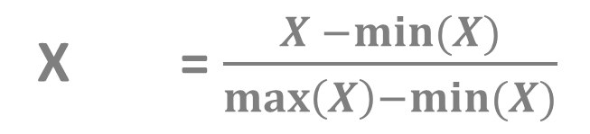
Confusion Matrix
MIN-MAX NORMALIZATION
this process transforms a feature such that all of its values
fall in a range between 0 and 1
normalized feature values can be interpreted as indicating how
far from 0% to 100% the original value fall along the
range between the original minima and maxima
X = $\frac{X −min⁡(X)}{\max\left(X\right)−min⁡(X)}$
new

Slide 64
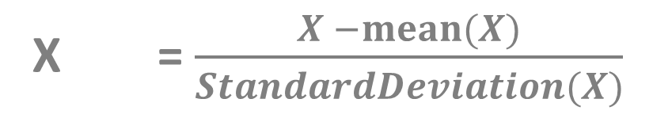
Confusion Matrix
Z-SCORE TRANSFORMATION
it is a way of normalizing the dataset as well: the algorithm
uses mean and standard deviation to do so
X = $\frac{X −mean⁡(X)}{StandardDeviation(X)}$
new
for Principle Component Analysis (PCA) we prefer using z-score normalization
but for image processing pixel intensities have to be normalized to fit within a
certain range + neural networks requires data that on a 0-1 scale

Slide 65
K-Nearest Neighbors Classifier (Machine Learning in Python)

Slide 66
K-Nearest Neighbors Classifier
it was first developed by Evelyn Fix and Joseph Hodges in 1951
k-nearest neighbors (kNN) classifier can classify examples by assigning them the class of the most similar labeled examples
very simple BUT extremely powerful algorithm
kNN is well suited for classification tasks where the relationships between the features are very complex and hard to understand

Slide 67
K-Nearest Neighbors Classifier
we have a training dataset so examples that are classified into several categories
we have a new example (with the same number of features as the training data) kNN algorithm identifies k elements in the training dataset that are the „nearest” in similarity
the unlabeled test example is assigned to the class of the majority of the k nearest neighbors

Slide 68
K-Nearest Neighbors Classifier
INGREDIENTS
SWEETNESS
CRUNCHINESS
TYPE
apple 10 9 fruit
bacon 1 4 protein
banana 10 1 fruit
carrot 7 10 vegetable
cheese 1 1 protein

Slide 69
K-Nearest Neighbors Classifier
INGREDIENTS
SWEETNESS
CRUNCHINESS
TYPE
apple 10 9 fruit
bacon 1 4 protein
banana 10 1 fruit
carrot 7 10 vegetable
cheese 1 1 protein
tomato 6 4 ???

Slide 70
K-Nearest Neighbors Classifier
crunchiness
carrot
cucumber
apple
bacon
orange
fish
banana
cheese
sweetness

Slide 71
K-Nearest Neighbors Classifier
crunchiness
carrot
cucumber
apple
bacon
orange
fish
banana
cheese
sweetness

Slide 72
K-Nearest Neighbors Classifier
crunchiness
the algorithm needs a distance-function to be able
to classify new data points (such as tomato)
Euclidean-distance or Manhattan-distance
carrot
cucumber
apple
tomato
bacon
orange
fish
banana
cheese
sweetness

Slide 73
K-Nearest Neighbors Classifier
lazy learners does not learn anything
we just store the training data – training is very fast (because there is no training at all) but making the prediction is rather slow (calculating the distances is expensive)
this is who dimension reduction approaches can be applied with principle components (PCA)
WE DO NOT BUILD A MODEL !!!
this is a non-parametric learning so no parameters are to be learned about the data
with linear regression and logistic regression we have to learn the b parameters either with gradient descent or with maximum likelihood method

Slide 74
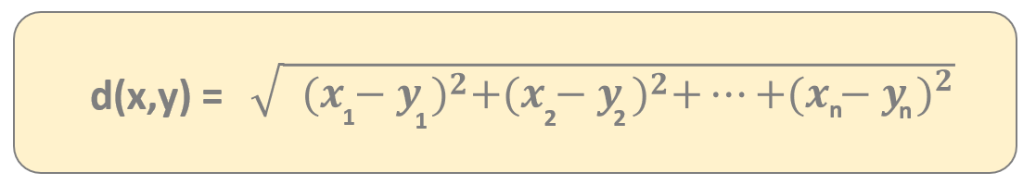
K-Nearest Neighbors Classifier
There are several types of distance metrics
Q(x₂, y₂)
in mathematics a metric or distance function is a function
that gives a distance between each pair of
point elements of a set
THIS IS HOW WE CAN MEASURE THE SIMILARITY !!!
d(P,Q)
P(x₁, y₁)
„Euclidean-distance”

Slide 75
K-Nearest Neighbors Classifier
There are several types of distance metrics
Q(x₂, y₂)
in mathematics a metric or distance function is a function
that gives a distance between each pair of
point elements of a set
THIS IS HOW WE CAN MEASURE THE SIMILARITY !!!
d(P,Q)
P(x₁, y₁)
dist(x,y) = |x₁-y₁| + |x₂-y₂| + ... + |x_{n}-y_{n}|
„Manhattan-distance”

Slide 76
K-Nearest Neighbors Classifier
EUCLIDEAN-DISTANCE
usually not recommended in higher dimensions
scales poorly with the number of dimensions
we can deal with the square euclidean distance as well
MANHATTAN-DISTANCE
Manhattan-distance is usually preferred
scales well with the number of dimensions

Slide 77
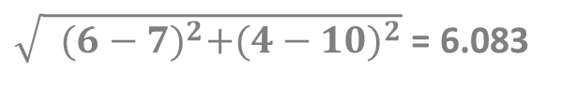
K-Nearest Neighbors Classifier
crunchiness
the algorithm needs a distance-function to be able
to classify new data points (such as tomato)
Euclidean-distance or Manhattan-distance
carrot
cucumber
apple
dist(tomato,carrot) =
$\sqrt{{ {(6−7)}^{2}+(4−10)}^{2}}$ = 6.083
tomato
bacon
orange
fish
banana
cheese
sweetness

Slide 78
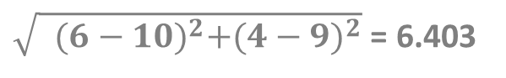
K-Nearest Neighbors Classifier
crunchiness
the algorithm needs a distance-function to be able
to classify new data points (such as tomato)
Euclidean-distance or Manhattan-distance
carrot
cucumber
apple
dist(tomato,apple) =
$\sqrt{{ {(6−10)}^{2}+(4−9)}^{2}}$ = 6.403
tomato
bacon
orange
fish
banana
cheese
sweetness

Slide 79
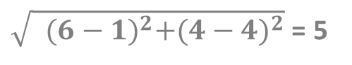
K-Nearest Neighbors Classifier
crunchiness
the algorithm needs a distance-function to be able
to classify new data points (such as tomato)
Euclidean-distance or Manhattan-distance
carrot
cucumber
apple
dist(tomato,bacon) =
$\sqrt{{ {(6−1)}^{2}+(4−4)}^{2}}$ = 5
tomato
bacon
orange
fish
banana
cheese
sweetness

Slide 80
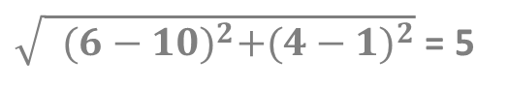
K-Nearest Neighbors Classifier
crunchiness
the algorithm needs a distance-function to be able
to classify new data points (such as tomato)
Euclidean-distance or Manhattan-distance
carrot
cucumber
apple
dist(tomato,banana) =
$\sqrt{{ {(6−10)}^{2}+(4−1)}^{2}}$ = 5
tomato
bacon
orange
fish
banana
cheese
sweetness

Slide 81
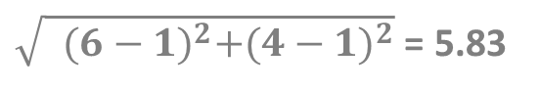
K-Nearest Neighbors Classifier
crunchiness
the algorithm needs a distance-function to be able
to classify new data points (such as tomato)
Euclidean-distance or Manhattan-distance
carrot
cucumber
apple
dist(tomato,cheese) =
$\sqrt{{ {(6−1)}^{2}+(4−1)}^{2}}$ = 5.83
tomato
bacon
orange
fish
banana
cheese
sweetness

Slide 82
K-Nearest Neighbors Classifier
crunchiness
k=1
we consider the smallest distance (bacon and banana)
k=2
we consider the 2 smallest distances (bacon and banana)
50%-50% that tomato is a fruit or a protein
carrot
k=3
we consider the 3 smallest distances bacon, banana
and cheese so tomato appears to be a protein
cucumber
apple
tomato
bacon
orange
fish
banana
cheese
sweetness

Slide 83
K-Nearest Neighbors Classifier
BIAS AND VARAINCE TRADE-OFF
bias and variance trade-off is an important concept in machine learning
the bias is the error from the incorrect assumptions in the algorithm
high bias (underfitting) oversimplifies the model and miss the relationships between the features and target variables
E[H(x)] – y
the bias is essentially the difference between
the model predition and the label

Slide 84
K-Nearest Neighbors Classifier
BIAS AND VARAINCE TRADE-OFF
bias and variance trade-off is an important concept in machine learning
variance is the error from the sensitivity to random fluctuations in the training dataset
high variance (overfitting) focuses on the training data and does not generalize well on data it has not seen before
E[(H(x)– E[H(x)])²]
the variance is the expected value of the squared
deviation of a random variable from its mean

Slide 85
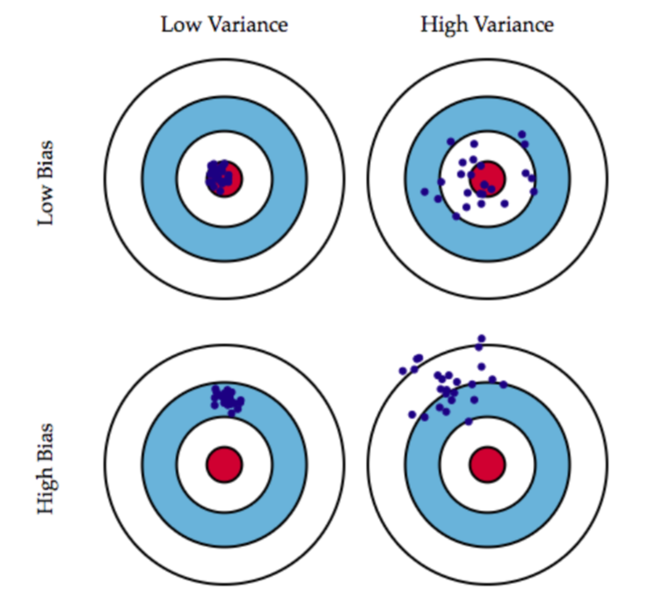
K-Nearest Neighbors Classifier
BIAS AND VARIANCE TRADE-OFF

Slide 86
K-Nearest Neighbors Classifier
BIAS AND VARIANCE TRADE-OFF
this is the case of
underfitting

Slide 87
K-Nearest Neighbors Classifier
BIAS AND VARIANCE TRADE-OFF
this is the case of
overfitting

Slide 88
K-Nearest Neighbors Classifier
HOW TO CHOOSE THE OPTIMAL K VALUE
Deciding how many neighbors to use for kNN determines how well the model will generalize and work on other datasets. There is a trade-off between bias and variance.
SMALL k VALUE
noisy data or outliers have a huge
impact on our classifier
this is the case of overfitting
high variance and low
bias model
LARGE k VALUE
the classifier has the tendency to
predict the majority class regardless
of which neighbors are nearest
this is called underfitting
variance is low but the
bias is high

Slide 89
Normalization
features are usually transformed into a range before the kNN algorithm is applied
WHY?
the distance formula depends on how features are measured
if certain features have much larger values than others → the distance measurements will be strongly dominated by the larger values
we have to rescale the various features such that each one contributes relatively equally to the distance formula
1.) min-max normalization
2.) z-transformation

Slide 90
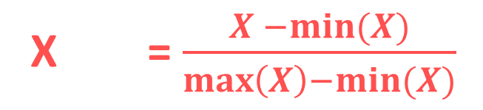
Normalization
MIN-MAX NORMALIZATION
→ this process transforms a feature such that all of its values fall in a range
between 0 and 1
normalized feature values can be interpreted as indicating how far, from 0%
to 100%, the original value fall along the range between the original minima and
maxima
X = $\frac{X −min⁡(X)}{\max\left(X\right)−min⁡(X)}$
new

Slide 91
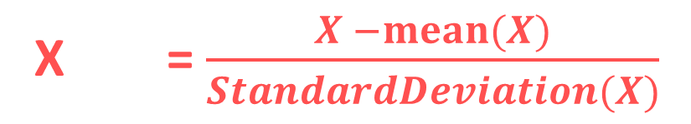
Normalization
Z-SCORE NORMALIZATION (STANDARDIZATION)
it is a way of normalizing the dataset as well: the algorithm
uses mean and standard deviation to do so
X = $\frac{X −mean⁡(X)}{StandardDeviation(X)}$
new
For Principle Component Analysis we prefer using z-score normalization
~ but for image processing: pixel intensities have to be normalized to fit within a
certain range + neural networks requires data that on a 0-1 scale

Slide 92
Naïve Bayes Classifier (Machine Learning in Python)

Slide 93
Naive Bayes Classifier
naive bayes classifier is a very efficient supervised learning classification algorithm
it scales well even in high dimensions (several features)
it is able to compete with SVM or random forest classifiers
naive bayes classifier can make good predictions even when the training data is relatively small
WHY IS IT CALLED NAIVE?
the naive assumption is that each input variable (feature) is independent

Slide 94
Naive Bayes Classifier
Naive means there is a strong independence assumptions
between the given features (input variabes)
For example: a fruit can be considered to be an apple if it is red, rounded
and about 8 cm in diameter
→ naive Bayes classifier considers each of these features contribute
independently to the probability that this fruit is an apple
→ it does not care about the correlation between color,
roundness, diameter and other features

Slide 95
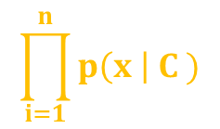
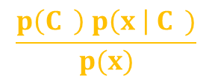
Naive Bayes Classifier
ABSTRACT MATHEMATICAL APPROACH
x are the features
P(C | x x ... x )
this model relies heavily on conditional probability
k
1
2
n
C is the possible
outcome of k classes
$$\frac{p\left(C \right) p\left(x \right| C )}{p(x)}$$
this is the Bayes theorem stating that
we can decompose the conditional probability
P(C | x x ... x ) =
k
-
k
k
1
2
n
-
the same for all c values
k
P( x x ... x | C ) = P(x | C ) P(x | C ) ... P(x | C )
FEATURES ARE INDEPENDENT
THIS IS WHY THE PROBABILITY IS
EASIER TO COMPUTE !!!
1
2
n
k
1
k
2
k
n
k
$$\prod_{i=1}^{n}{p\left(x \right| C )}$$
P(C | x x ... x ) p(C )
k
1
2
n
~
k
i
k

Slide 96
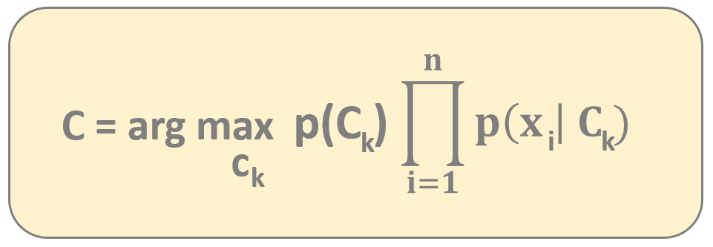
Naive Bayes Classifier
ABSTRACT MATHEMATICAL APPROACH
If we assume the features are independent we can come up with
a powerful probability-based classification algorithm
→ we have to choose the C class with the highest probability
k
NAIVE BAYER CLASSIFIER FORMULA

Slide 97
Naive Bayes Classifier
DISADVANTAGES
naive Bayes classifier has the
assumption that the features
are independent ...
... and of course it is usally
not true at all

Slide 98
Naive Bayes Classifier
DISADVANTAGES
naive Bayes classifier has the
assumption that the features
are independent ...
... and of course it is usally
not true at all
ADVANTAGES
it is relatively simple
to undertand the model
it is a relatively fast algorithm
and can be trained on
small datasets as well
naive Bayes classifier is
not sensitive to
irrelevant features

Slide 99
Naive Bayes Classifier
Why is it so powerful with text classification?
The 2 assumptions of naive Bayes classifier:
→ the probability of occurrence of any word given the class label is
independent of the probability of occurrence of
any other word given that label
→ the probability of occurrence of a word in a document is independent
of the location of that word within the document
It is the same assumption of bag-of-words model – documents are
just a bunch of words thrown together
THESE ASSUMPTIONS ARE TRUE FOR TEXT CLASSIFICATION !!!

Slide 100
Naive Bayes Classifier

Slide 101
Naive Bayes Classifier
x

Slide 102
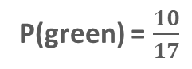
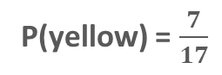
Naive Bayes Classifier
P(yellow) = $\frac{7}{17}$
P(green) = $\frac{10}{17}$
x

Slide 103
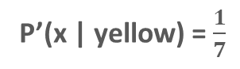
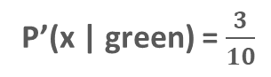
Naive Bayes Classifier
P(yellow) = $\frac{7}{17}$
P’(x | green) = $\frac{3}{10}$
P(green) = $\frac{10}{17}$
P’(x | yellow) = $\frac{1}{7}$
x

Slide 104
Naive Bayes Classifier
P(yellow) = $\frac{7}{17}$
P’(x | green) = $\frac{3}{10}$
P(green) = $\frac{10}{17}$
P’(x | yellow) = $\frac{1}{7}$
x
posterior probability P’’(x is green ) = P(green) * P’(x | green) = $\frac{10}{17}$ * $\frac{3}{10}= \frac{30}{170}$

Slide 105
Naive Bayes Classifier
P(yellow) = $\frac{7}{17}$
P’(x | green) = $\frac{3}{10}$
P(green) = $\frac{10}{17}$
P’(x | yellow) = $\frac{1}{7}$
x
posterior probability P’’(x is green ) = P(green) * P’(x | green) = $\frac{10}{17}$ * $\frac{3}{10}= \frac{30}{170}$
posterior probability P’’(x is yellow ) = P(yellow) * P’(x | yellow) = $\frac{7}{17}$ * $\frac{1}{7}= \frac{7}{119}$

Slide 106
Naive Bayes Classifier
P(yellow) = $\frac{7}{17}$
P’(x | green) = $\frac{3}{10}$
P(green) = $\frac{10}{17}$
P’(x | yellow) = $\frac{1}{7}$
x
posterior probability P’’(x is green ) = P(green) * P’(x | green) = $\frac{10}{17}$ * $\frac{3}{10}= \frac{30}{170}$
posterior probability P’’(x is yellow ) = P(yellow) * P’(x | yellow) = $\frac{7}{17}$ * $\frac{1}{7}= \frac{7}{119}$

Slide 107
Decision Trees
Decision Tree is a type of supervised learning approaches: mostly used in classification
problems but it can be used for regression as well
~ works fine for both categorical variables and continuous input as well
→ very similar to search trees
→ split the data/population into two or more homogeneous sets
based on significant splitter in input variables

Slide 108
Decision Trees
Decision Tree is a type of supervised learning approaches: mostly used in classification
problems but it can be used for regression as well
~ works fine for both categorical variables and continuous input as well
→ very similar to search trees
→ split the data/population into tow or more homogeneous sets
based on significant splitter in input variables
For example: we have a single
feature x, the number of hours a
student spent with studying
Want to predict the y probability
of passing the exam
we split on x
x < 5
x > 5
Categorical Variable Decision Tree:
→ categorical target variable such as yes/no or fail/pass
Continuous Variable Decision Tree:
→ continuous target variable: such as for regression
FAIL
PASS

Slide 109
Decision Trees
root node: represent the entire dataset/population and this
further gets divided into several subsets
~ root node corresponds to the best predictor
decision node: the algorithm splits the
node into sub-nodes based on given
feature in the dataset
leaf nodes: with no children
~ the values are what we are after
HOW TO DECIDE WHAT NODES (FEATURES) ARE IMPORTANT?
WHAT SHOULD BE THE ROOT NODE?

Slide 110
Decision Trees
Decision Tree classifier accuracy depends heavily on splits
Hot to construct the tree? What are the nodes?
There are several algorithms for this problem:
1.) Gini Index Approach
2.) Calculating the information entropy (ID3 algorithm or C4.5 approach)
3.) algorithm based on variance reduction

Slide 111
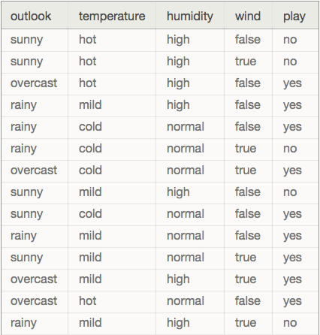
Decision Trees
We are dealing with categorical variables (predictors)
or features: outlook, temperature, humidity, wind
~ we want to predict whether to play
golf or not (play is he target variable)

Slide 112
Decision Trees
OUTLOOK
SUNNY
OVERCAST
RAINY
WINDY
YES
HUMIDITY
TRUE
FALSE
HIGH
NORMAL
YES
NO
NO
YES

Slide 113
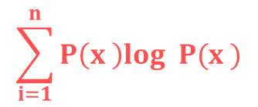
Decision Trees
Usually ID3 algorithm is used to build the decision tree:
~ it is a top-down greedy search of possible branches
→ it uses entropy and information gain to build the tree
The H(X) Shannon-entropy of a dicrete random variable X with possible values
x x ... x and probability mass function P(X) is defined as:
1
2
n
$$\sum_{i=1}^{n}{P\left(x \right)log P(x )}$$
H(X) = -
i
2
i
Example: https://en.wikipedia.org/wiki/Entropy_(information_theory)
For completely homogoeneous dataset (all TRUE or all FALSE values): entropy is 0
If the dataset is equally divided (same amount of TRUEs and FALSEs): entropy is 1
A BRANCH WITH ENTROPY MORE THAN 1 NEEDS SPLITING !!!
+ root node has the maximum information gain (entropy reduction)
+ leaf nodes have entropy 0

Slide 114
Decision Trees
PLAYING GOLF
→ 9 times YES
→ 5 times NO
We just have to use the Shannon-entropy formula
to calculate the H(x) values
H(PlayingGolf) = H(9,5) =
= -(0.64 log 0.64) – (0.36 log 0.36) = 0.94
2
2

Slide 115
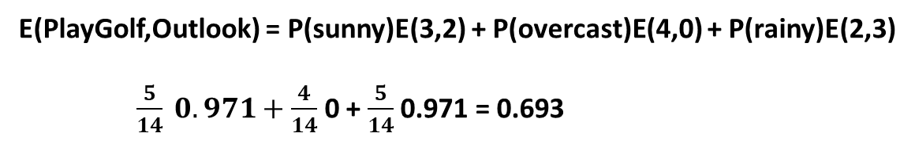
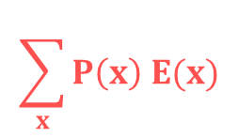
Decision Trees
$$\sum_{x}{P\left(x\right) E(x)}$$
E(T,X) =
We have to calculate the entropy with respect to
a given predictor/feature in order to be able to
calculate information gain
PLAY GOLF
YES NO
sunny 3 2
overcast 4 0
rainy 2 3
OUTLOOK
E(PlayGolf,Outlook) = P(sunny)E(3,2) + P(overcast)E(4,0) + P(rainy)E(2,3)
$\frac{5}{14} 0.971+\frac{4}{14}$ 0 + $\frac{5}{14}$ 0.971 = 0.693

Slide 116
Decision Trees
Information gain: the decrease in entropy after a dataset is
split on an attribute/feature
→ feature/attribute with the highest information
gain will be the root node in the tree
Information Gain = H(PlayGolf) - E(PlayGolf,Outlook) =
= 0.64 – 0.693 = 0.247
PLAY GOLF
YES NO
sunny 3 2
overcast 4 0
rainy 2 3
OUTLOOK

Slide 117
Decision Trees
Information gain: the decrease in entropy after a dataset is
split on an attribute/feature
→ feature/attribute with the highest information
gain will be the root node in the tree
Information Gain (outlook) = 0.247
Information Gain (temperature) = 0.029
Information Gain (humidity) = 0.152
Information Gain (wind) = 0.048

Slide 118
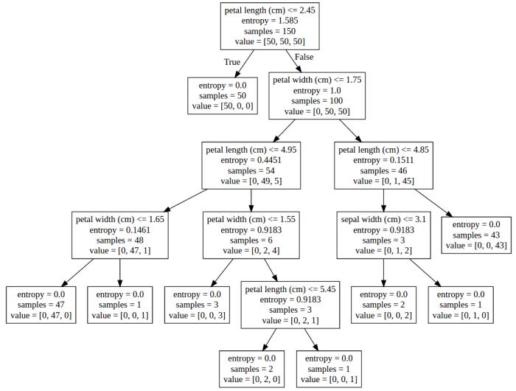
Decision Trees
IRIS-SETOSA
IRIS-VERSICOLOR
IRIS-VIRGINICA

Slide 119
Decision Trees
Most significant problem: every split it makes at each node is
optimized for the dataset it is fit to
~ this splitting process will rarely generalize well to other data !!!

Slide 120
Decision Trees
ADVANTAGES
easy to understand and interpret
it is one of the best approaches to identify most significant variables
and the relationships between the variables
no need for data preprocessing
Decision trees are not influenced by outliers for example
can handle numerical variables as well as categorical variables
Categorical variables: YES/NO or SUNNY/RAINY
DISADVANTAGES
have the tendency to overfit
~ we can solve it by pruning for example
decision trees can be unstable because small variations in the data might
result in a completely different tree being generated
~ generating the optimal tree is NP-complete: heuristic solutions are used (greedy approach)

Slide 121
Gini Index Approach
CART (Classification and Regression Tree) algorithm uses Gini indexes to
decide how to make the splits
using Gini Index Approach is a bit better than
calculating the information gain and entropy
THE ALGORITHMS ARE APPROXIMATELY THE SAME !!!
when dealing with entropy: we have to calculate logarithmic
functions, which are computationally expensive
~ thats why we prefer Gini Index Approach

Slide 122
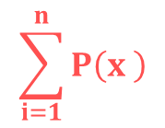
Gini Index Approach
$$\sum_{i=1}^{n}{P\left(x \right)}$$
G(X) = 1 -
2
i
This is the formula we have to use in order to calculate
the Gini-index of a X random variable
E(s,t) = G(t) – P(left) G(left_t) – P(right) G(right_t)
As we have seen for Information Gain, here as well we have to calculate
the Gini-index concerning a given split
WE SPLIT THE FEATURE WITH THE LOWEST GINI-INDEX

Slide 123
Gini Index Approach
PLAYING GOLF
→ 9 times YES
→ 5 times NO
We just have to use the Gini-index formula
to calculate the G(x) values
G(PlayingGolf) = G(9,5) =
= 1 - 0.64 - 0.36 = 0.46
2
2

Slide 124
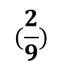
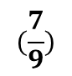
Gini Index Approach
E(s,t) = G(t) – P(left) G(left_t) – P(right) G(right_t)
Gini-index for
input node t
proportion of observation
in the left node after splitting
+ Gini-index of the left node
after splitting
proportion of observation
in the right node after splitting
+ Gini-index of the right node
after splitting
DEFAULT
YES NO
GENDER
male 3 2
female 4 0
$$(\frac{7}{9})$$
$$(\frac{2}{9})$$
2
2
G(t) = 1 - - = 0.3432

Slide 125
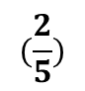
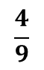
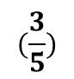



Gini Index Approach
E(s,t) = G(t) – P(left) G(left_t) – P(right) G(right_t)
Gini-index for
input node t
proportion of observation
in the left node after splitting
+ Gini-index of the left node
after splitting
proportion of observation
in the right node after splitting
+ Gini-index of the right node
after splitting
DEFAULT
YES NO
GENDER
male 3 2
female 4 0
$$(\frac{3}{5})$$
$$(\frac{2}{5})$$
2
2
G(male) = 1 - - = 0.48
$$(\frac{4}{4})$$
$$(\frac{0}{4})$$
2
2
G(female) = 1 - - = 0
$$\frac{5}{9}$$
$$\frac{4}{9}$$
E(s,t) = 0.34 – 0.48 - 0 = 0.07

Slide 126
Pruning and Bagging
What is the aim when dealing with machine learning algorithms? We want to choose
a model that capture the relatinships within the training dataset
+ generalizes well to unseen data (test set)
GENERALLY IT IS IMPOSSIBLE TO ACHIEVE BOTH OF THEM AT THE SAME TIME
~ this is called the bias-variance trade-off

Slide 127
Pruning and Bagging
bias: error from misclassifications in the learning algorithm
High bias → the algorithm misses the relevant relationships
between features and target outputs (underfitting)
ERROR DUE TO MODEL MISMATCH
variance: error from sensitivity to small changes in the training set
High variance → can cause overfitting (the algorithm models the noise)
VARIATION DUE TO TRAINING SAMPLE AND RANDOMIZATION
bias / variance trade-off
~ we are not able to optimize both bias and variance at the same time
low bias → high variance
low variance → high bias

Slide 128

Pruning and Bagging
http://scott.fortmann-roe.com/docs/BiasVariance.html

Slide 129
Pruning
usually decision trees are likely to overfit the data leading to poor test performance
+ trees are unstable classifiers: if you perturb the data a little the tree might significantly change
(low bias but high variance model !!!)
smaller tree + fewer splits → better predictor at the cost of a little extra bias
better solution: grow a large tree and then prune it back to a smaller subtree
„weakest link pruning”

Slide 130
Pruning
BEFORE PRUNING

Slide 131
Pruning
AFTER PRUNING

Slide 132
Bagging
BOOTSTRAP AGGREGATION
A rather counter-intuitive theory: a weak learner is not able to make
good predictions
→ weak learner is just a bit better than random guess or coin flip
For example: decision trees with depth 1
→ combining weak learners can prove to be an extremely
powerful classifier !!!
„wisdom of the crowd”
(Black-Scholes model is approximately the same: two risky
positions taken together can effectively eliminate risk itself)

Slide 133

Bagging
BOOTSTRAP AGGREGATION
reduces the variance of a learning algorithm
if we have a X set of n independent varibles x , x , ... , x each with variance V then the
variance of the mean X ( the mean of the x , x ... x variables ) is $\frac{V}{n}$
1
2
n
1
2
n
WE CAN REDUCE THE VARIANCE BY AVERAGING A SET OF OBSERVATIONS !!!
good idea: have multiple training sets and construct a decision tree (without pruning)
on every single training set !!!
→ PROBLEM: we do not have several training sets

Slide 134
Bagging
BOOTSTRAP AGGREGATION
we should take repeated samples from the single data set + construct trees + average
all the predictions in the end
~ all the trees are fully grown unpruned decision trees
THIS IS CALLED BAGGING !!!
pruning: variance decreases but we have some bias ... here we can reduce
the variance without extra bias
Regression problem: we take the average
Classification problem: we take the majority vote

Slide 135
Bagging
BOOTSTRAP AGGREGATION
One problem with bagging: the constructed trees are highly correlated
Why do correlation occur?
Because every dataset has a strong predictor/feature. All the bagged trees
tend to make the same splits because they all share the same features !!!
~ because of this all of these trees look very similar
TREE #1
TREE #2
TREE #3
TREE #4
CORRELATED TREES BECAUSE WE USE ALL THE FEATURES

Slide 136

Random Forest Classifier
better than bagging: this algorithm decorrelates the single decision trees that has been constructed
this reduces the variance even more when averaging the trees
similar to bagging: we keep constructing decision trees on the training data BUT on every split in the tree, a random selection of features / predictors is chosen from the full feature set
The number of features considered at a given split is approximately equal to the square root of the total number of features (for classification)
Bagging: algorithm searches over all the N features to find
the best feature that best splits the data at that node
Random Forest Classifier: algorithm searches over a random $\sqrt{N}$ features to
find the best one

Slide 137
Random Forest Classifier
X dataset
N features
N features
N features
N features
1
2
3
4
TREE #1
TREE #2
TREE #3
TREE #4
CLASS C
CLASS D
CLASS B
CLASS C
MAJORITY VOTING
FINAL CLASS

Slide 138
Random Forest Classifier
Why is it good?
if one or a few features are very strong predictors for the response variable (target output), these features will be selected in many of the decision trees: so they will become correlated
huge advantage: at some point the variance stops decreasing no matter how many more trees we add to our random forest + it is not going to produce overfitting !!!

Slide 139
Boosting
it can be used for classification and regression too
helps to reduce variance and bias !!!
bagging: creates multiple copies of the original data: constructs several decision trees on the copies and combining all the trees to make predictions
WE CONSTRUCT THESE TREES INDEPENDENTLY !!!
boosting: here the decision trees are grown sequentially so each tree is grown using information from previously grown trees
THESE TREES ARE NOT INDEPENDENT OF EACH OTHER
~ boosting is a sequential learning algorithm

Slide 140
Boosting
A rather counter-intuitive theory: a weak learner is not able to make
good predictions
→ weak learner is just a bit better than random guess or coin flip
For example: decision trees with depth 1
→ combining weak learners can prove to be an extremely
powerful classifier !!!
→ by fitting small trees (decision stumps) we slowly improve the final result
in cases when it does not perform well
We will consider adaptive boosting „AdaBoost” algorithm !!!

Slide 141
Boosting Applications
Viola-Jones Face Detection algorithm uses boosting
~ combines decision stumps to detect faces
→ weak learners decide whether the given section of the image
contains a face or not
→ extremely accurate and fast algorithm

Slide 142
Boosting
For example: we want to classify the dots
~ two x features + two output classes (yellow and green)
Boosting: combines very simple weak learners such as
decision trees with depth 1 (capable of linear classification)
x
2
x
1

Slide 143
Boosting
For example: we want to classify the dots
~ two x features + two output classes (yellow and green)
Boosting: combines very simple weak learners such as
decision trees with depth 1 (capable of linear classification)
→ the classifier made 2 mistakes: two yellow
dots are misclassified
→ boosting algorithm: in the next iteration it
will focus on the misclassified items
Increase the w weights: for misclassified items
Decrease the w weights: for correctly classified items
x
2
x
1

Slide 144
Boosting
For example: we want to classify the dots
~ two x features + two output classes (yellow and green)
Boosting: combines very simple weak learners such as
decision trees with depth 1 (capable of linear classification)
→ the classifier made 2 mistakes: two yellow
dots are misclassified
→ boosting algorithm: in the next iteration it
will focus on the misclassified items
Increase the w weights: for misclassified items
Decrease the w weights: for correctly classified items
x
2
x
1

Slide 145
Boosting
For example: we want to classify the dots
~ two x features + two output classes (yellow and green)
Boosting: combines very simple weak learners such as
decision trees with depth 1 (capable of linear classification)
→ the classifier made 2 mistakes: two yellow
dots are misclassified
→ boosting algorithm: in the next iteration it
will focus on the misclassified items
Increase the w weights: for misclassified items
Decrease the w weights: for correctly classified items
x
2
x
1

Slide 146
Boosting
For example: we want to classify the dots
~ two x features + two output classes (yellow and green)
Boosting: combines very simple weak learners such as
decision trees with depth 1 (capable of linear classification)
→ the classifier made 2 mistakes: two yellow
dots are misclassified
→ boosting algorithm: in the next iteration it
will focus on the misclassified items
Increase the w weights: for misclassified items
Decrease the w weights: for correctly classified items
x
2
x
1
WE JUST HAVE TO COMBINE THESE WEAK CLASSIFIERS !!!

Slide 147





Boosting
we keep combining h(x)
weak learners (each learner knows just a
little fraction of the space)
$$\sum_{i=1}^{n}{α h \left(x\right)}$$
H(x) = sign
i
i
final H(x) model which
is a strong classifier
// we assign +1 and -1 for the output classes (yellow and green)
$$\frac{1}{N}$$
→ we initialize the weights parameters at the beginning w =
i
$$\sum_{i=1}^{n}{w}$$
= 1
we make sure this is a distribution
i
$$\sum_{wrong}{w}$$
ε =
error is the sum of the misclassified weights
i

Slide 148








Boosting
$$\frac{1}{N}$$
initialize the weights at the beginning
w =
i
pick h (x) that minimizes
the ε error term
$$\sum_{wrong}{w}$$
t
ε =
t
i
$$\frac{1}{\text{2}}$$
$$\frac{1−\text{ε}}{\text{ε}}$$
we can calculate $α$
t
$α$ = ln ( )
t
t
t
t
- $α$ h (x) y(x)
t+1
$$\frac{w}{\text{Z}}$$
i
t
t
update w weight
w = e
t+1
i
On every iteration we add a new h(x) weak learner to the final model

Slide 149




Boosting
$$\frac{1}{\text{2}}$$
$$\frac{1−\text{ε}}{\text{ε}}$$
t
$α$ = ln ( )
t
t
given h(x) classifier α value increases as the error
converges to 0: of course, good classifiers are
given more weight
given h(x) classifier α value is 0 if the error is 0.5
Why? Because it is a random guess (coin toss)
~ we do not want our algorithm to rely on random guesses
we give negative α value for h(x) classifiers that are worse
than random guesses
~ we do the opposite thats the best action
This α parameter as something to do with the h(x) learners !!!

Slide 150


Boosting
t
- $α$ h (x) y(x)
this is how we update the weights
in every iteration
t+1
$$\frac{w}{\text{Z}}$$
i
t
t
w = e
i
the w weights have something to do with the dataset
we set higher weights to more important samples and lower weight
values to less important ones
→ the Z makes sure w is a distribution so the sum is 1
→ y(x) flips the sign of the exponent if h(x) is wrong
Why is it good? It makes sure to assign smaller weights to samples
that are correctly classified and bigger weights for misclassification
~ in the next iteration the next h(x) learner can focus on those samples with higher weights
Why to use α in the formula? This is how we make sure that stronger classfiers’ decisions are more important
If a weak classifier misclassifies an input we do not take that
as seriously as a strong classifier’s mistake

Slide 151
Boosting and Bagging
BAGGING BOOSTING
both bagging and boosting use N learners + yields more stable models
every item has the same probability
to appear in a new dataset
the samples are weighted so some
of them will occur more often
parallel training stage
builds learners in sequential way
final decision is the average
of the N learners
final decision is the weighted average
of the N learners
(better classifiers have higher weights)
reduces variance and
solves over-fitting
reduces bias but
increases over-fitting a bit
PREFERRED

Slide 152
Support Vector Machines (SVMs) (Machine Learning in Python)

Slide 153
Support Vector Machines (SVMs)
very popular and widely used supervised learning classification algorithm
the great benefit is that it can operate even in infinite dimensions
it defines a margin (decision boundary) between the data points in the multidimensional space
the goal is to find a flat boundary ( also known as the hyperplane) that leads to a homogeneous partition of the data
a good separation is achieved by the hyperplane that has the largest distance to the nearest training-data point of any class since in general the larger the margin the lower the generalization error of the classifier
SO WITH SUPPORT VECTOR MACHINE ALGORITHM WE MAXIMIZE THE MARGIN

Slide 154
Support Vector Machines (SVMs)
x
2
x
1

Slide 155
Support Vector Machines (SVMs)
x
2
we want to find a hyperplane
in this case a linear line that separates
the different data points with
the maximum margin
x
1

Slide 156
Support Vector Machines (SVMs)
x
2
we want to find a hyperplane
in this case a linear line that separates
the different data points with
the maximum margin
x
1

Slide 157
Support Vector Machines (SVMs)
x
2
we are looking for the margin (decision
boundary) with the largest width
THIS IS THE MAXIMUM MARGIN !!!
x
1

Slide 158
Support Vector Machines (SVMs)
the points that are closest to the
maximum margin are called
the support-vectors
THE SUPPORT VECTORS STORE
THE INFORMATION FOR THE
DECISION BOUNDARY !!!
if we change the positions (feature values)
of other data points then
nothing happens
~ but if we change the support vectors
then the model changes as well
x
2
x
1

Slide 159
Support Vector Machines (SVMs)
each class have at least one support vector
we can use the support vectors exclusively to reconstruct the hyerplane so the decision boundary
THIS IS AN EXTREMELY POWERFUL FEATURE
the classification model can be stored even when there are an extemely huge amount of features

Slide 160
Support Vector Machines (SVMs) (Machine Learning in Python)

Slide 161
Support Vector Machines (SVMs)
in geometry a hyperplane is a subspace
that has one dimension fewer than
its ambient space
THE HYPERPLANE SEPARATES THE
SPACE INTO TWO PARTS !!!
the general equation for a
hyperplane is w^{T}x + b = 0
x
2
x
1

Slide 162
Support Vector Machines (SVMs)
in geometry a hyperplane is a subspace
that has one dimension fewer than
its ambient space
THE HYPERPLANE SEPARATES THE
SPACE INTO TWO PARTS !!!
the general equation for a
hyperplane is w^{T}x + b = 0
x
2
y = ax + b
y - ax - b = 0
x
1

Slide 163
Support Vector Machines (SVMs)
in geometry a hyperplane is a subspace
that has one dimension fewer than
its ambient space
THE HYPERPLANE SEPARATES THE
SPACE INTO TWO PARTS !!!
the general equation for a
hyperplane is w^{T}x + b = 0
x
2
T
y = ax + b
y - ax - b = 0
1
y
- b = 0
-a
x
x
1

Slide 164
Support Vector Machines (SVMs)
x
2
y = -x + 5
y + x – 5 = 0
x
1

Slide 165
Support Vector Machines (SVMs)
(10,10)
x
2
(1,1)
y = -x + 5
y + x – 5 = 0
x
1

Slide 166
Support Vector Machines (SVMs)
(10,10)
T
1
1
- 5 = -3 < 0
1
1
x
2
(1,1)
y = -x + 5
y + x – 5 = 0
x
1

Slide 167
Support Vector Machines (SVMs)
(10,10)
T
1
10
- 5 = 15 > 0
1
10
x
2
(1,1)
y = -x + 5
y + x – 5 = 0
x
1

Slide 168
Support Vector Machines (SVMs)
>
>
>
x
>
2
>
<
<
<
y = -x + 5
y + x – 5 = 0
<
x
1

Slide 169
Support Vector Machines (SVMs)
x
2
H₁ = H+δ
H
H₂ = H-δ
x
1

Slide 170
Support Vector Machines (SVMs)
for all the data points in this
side of the hyperplane
w^{T}x + b > δ
x
2
for all the data points in this
side of the hyperplane
w^{T}x + b < -δ
H₁ = H+δ
H
H₂ = H-δ
x
1

Slide 171
Support Vector Machines (SVMs)
for all the data points in this
side of the hyperplane
w^{T}x + b > δ
for mathematical convenience we usually set the delta offset to one (δ=1) to simplify the design of the classifier and the output labels are +1 and -1 accordingly
x
2
for all the data points in this
side of the hyperplane
w^{T}x + b < -δ
H+δ
H
H-δ
x
1

Slide 172
Support Vector Machines (SVMs)
It is convenient to define δ=1
because it allows the classification constraints to be combined into a single constraint
we define the H hyperplane such that
w x_{i} + b ≥ 1 when y_{i} = 1 and
w x_{i} + b ≤ -1 when y_{i} = -1
y_{i}(w x_{i} + b) ≥ 1
this is the single constraint
we have to deal with !!!
(and of course support vectors are when y_{i}(w x_{i} + b) = 1)
x
2
H₁ = H+1
H
H₂ = H-1
x
1

Slide 173
Support Vector Machines (SVMs)
we define the H hyperplane such that
w x_{i} + b ≥ 1 when y_{i} = 1 and
w x_{i} + b ≤ -1 when y_{i} = -1
points on the H₁ and H₂ lines are
called the support vectors
the distance between H₁ and H₂ lines is δ₊ + δ₋
WHAT IS THE TOTAL DISTANCE BETWEEN H₁ AND H₂ ?
it is crucial because SVM is a maximum margin classifier so we have to maximize the distance
x
2
H₁ = H+1
H
H₂ = H-1
x
1

Slide 174


Support Vector Machines (SVMs)
the distance between H and H₁ (and this is the distance between H and H₂ as well) is defined by the following formula
and if we want to get the total distance between H₁ and H₁ then:
so this is a typical maximization problem
$$\frac{1}{|\left|w\right||}$$
x
2
H₁ = H+1
$$\frac{2}{|\left|w\right||}$$
H
H₂ = H-1
x
1

Slide 175

Support Vector Machines (SVMs)
every maximization problem can be transformed into a minimization problem
we can minimize this function instead and we can transform the problem into:
so this is a typical minimization problem
||w||
x
2
$\frac{1}{2}$ ||w||²
H₁ = H+1
min
w
H
y_{i}(w x_{i} + b) ≥ 1 i=1...N
H₂ = H-1
x
1

Slide 176
Support Vector Machines (SVMs)
every maximization problem can be transformed into a minimization problem
we can minimize this function instead and we can transform the problem into:
so this is a typical minimization problem
||w||
PRIMAL FORM OF
THE PROBLEM !!!
x
2
$\frac{1}{2}$ ||w||²
H₁ = H+1
min
w
H
y_{i}(w x_{i} + b) ≥ 1 i=1...N
H₂ = H-1
x
1

Slide 177
Support Vector Machines (SVMs) (Machine Learning in Python)

Slide 178
Support Vector Machines (SVMs)
the main problem is that in real-world problems are non-linearly separable
instead of classifying all the data points correctly – we allow some mistakes
in many real-world applications the relationships between variables are usually non-linear
a key feature of SVMs is their ability to map the problem into a higher dimensional space using a process known as the „kernel trick”
non-linear relationship may suddenly appears to be quite linear

Slide 179
Support Vector Machines (SVMs)
the main problem is that in real-world problems are non-linearly separable
instead of classifying all the data points correctly – we allow some mistakes
in many real-world applications the relationships between variables are usually non-linear
a key feature of SVMs is their ability to map the problem into a higher dimensional space using a process known as the „kernel trick”
non-linear relationship may suddenly appears to be quite linear

Slide 180
Support Vector Machines (SVMs)
x
a_{j}
2
a_{i}
we allow misclassifications
because real-world problems
can not be sepratared linearly
a_{i} (slack variables) define the
distances from the decision boundary
x
1

Slide 181


Support Vector Machines (SVMs)
$$\sum_{i}{a}$$
$\frac{1}{2}$ ||w||²
min [ ]
+ C
w
i
y_{i}(w x_{i} + b) ≥ 1-a_{i} i=1...N
C is the cost parameter to all points that violate the constraints
(by the way a_{i} is 0 for the points that are classified correctly)
we make our optimization on this cost function
we can tune the C parameter: we can modify the penalty
for the data points that are misclassified
C is very large then the algorithm tries to find a 100% separation
C is low then wider overall margin is allowed with more misclassified data points

Slide 182
Support Vector Machines (SVMs)
DISADVANTAGES
SVM deals with a large number
of parameters and kernels
quite slow especially when there is
a large number of features
quite hard to understand
„black box model”
there are no probabilities
associated with the predictions
ADVANTAGES
SVM can be used both for
regression and classification as well
it uses a subset of the dataset
(support vectors) in the decision
function so it is memory friendly
SVM is working fine
even in inifinite dimensions
easier to use than neural netoworks

Slide 183
Support Vector Machines (SVMs) (Machine Learning in Python)

Slide 184
Support Vector Machines (SVMs)
x₁
(latitude)
x₂
(longitude)

Slide 185
Support Vector Machines (SVMs)
φ(x)
„kernel function”
x₁
(latitude)
x₁² + x₂²
(alitude)
x₂
(longitude)
x₂
(longitude)
with the kernel function we can transform
the problem into a higher dimensional space
that is a linearly separable one
(additional variabe is altitude )

Slide 186
Support Vector Machines (SVMs)
φ(x)
„kernel function”
x₁
(latitude)
x₁² + x₂²
(alitude)
x₂
(longitude)
x₂
(longitude)
SVM LEARNS CONCEPTS (FEATURE) THAT WERE NOT EXPLlCITLY
MEASURED IN THE ORIGINAL DATASET !!!

Slide 187

Support Vector Machines (SVMs)
so with the help of the φ(x) kernel-function we transform all the points in the dataset one by one
and we end up with a higher dimensional space (because we have additional features)
in the loss-function we just have to use φ(x_{i}) * φ(x_{j})
after applying the kernel-function
BUT THIS IS EXPENSIVE IN COMPUTATION AND MEMORY HEAVY OPERATION AS WELL !!!

Slide 188

Support Vector Machines (SVMs)
so with the help of the φ(x) kernel-function we transform all the points in the dataset one by one
and we end up with a higher dimensional space (because we have additional features)
THIS IS WHY THE KERNEL TRICK IS SO POWERFUL
- we can calculate φ(x_{i}) * φ(x_{j}) without dealing with the higher dimensional features and data -
in the loss-function we just have to use φ(x_{i}) * φ(x_{j})
after applying the kernel-function
BUT THIS IS EXPENSIVE IN COMPUTATION AND MEMORY HEAVY OPERATION AS WELL !!!

Slide 189
Support Vector Machines (SVMs)
kernel-functions define inner products in the transformed (higher dimensional) space
IT DEFINES THE SIMILARITY IN THE TRANSFORMED SPACE !!!
the most powerful statement is that we do not need to compute φ(x) at all to compute K(x_{i},x_{j}) = φ(x_{i}) * φ(x_{j})

Slide 190
Support Vector Machines (SVMs)
kernel-functions define inner products in the transformed (higher dimensional) space
IT DEFINES THE SIMILARITY IN THE TRANSFORMED SPACE !!!
the most powerful statement is that we do not need to compute φ(x) at all to compute K(x_{i},x_{j}) = φ(x_{i}) * φ(x_{j})
K(x_{i},x_{j})

Slide 191

Support Vector Machines (SVMs)
K(x_{i} , x_{j} ) = x_{i} * x_{j}
linear kernel that does not transform the data
K(x_{i} , x_{j} ) = (x_{i} * x_{j} + 1)^{d}
polynomial kernel
2
-
|| x_{i} - x_{j} ||
K(x_{i} , x_{j} ) =
exp
gaussian radial basis function kernel
2σ²
These clculations are done on the original dataset so without applying the
$\text{φ}\text{(}\text{x}\text{)}$ kernel-function explicitly
WE DO NOT SEND THE DATA INTO THE HIGH DIMENSIOANL SPACE
BUT WE STILL GET ALL THE BENEFITS (THIS IS THE „KERNEL-TRICK”)

Slide 192
K-Means Clustering (Machine Learning in Python)

Slide 193
K-Means Clustering
was first proposed by Stuart Lloyd in 1957 and Edward W. Forgy published essentially the same method
this is why it is also known as Lloyd–Forgy algorithm
very popular unsupervised learning algorithm in data mining
automatically divides the data into clusters of similar items and it does this without having been told what the groups should look like ahead of time
PROBLEM: how could a computer possibly know where one group ends and another begins?
elements inside a cluster should be very similar to each other, but very different from those outside

Slide 194
K-Means Clustering
MAIN PROBLEM
– how could a computer possibly know where
one group ends and another begins? –
basic idea is that elements inside a cluster should be very similar
to each other but very different from those outside

Slide 195
K-Means Clustering
k-means clustering aims to partition N observations into k clusters in which each observation belongs to the cluster with the nearest mean
the same can be achieved with graph algorithms – we just ahve to construct the minimum spanning tree and remove the last k edges
it is an NP-hard problem (so quite hard to solve)
Lloyd-algorithm is very common nowadays

Slide 196
K-Means Clustering
initialize the centroids at random – these are the centers of a given cluster

Slide 197
K-Means Clustering
initialize the centroids at random – these are the centers of a given cluster
decide for every point in our dataset what centroid is the nearest to them

Slide 198
K-Means Clustering
initialize the centroids at random – these are the centers of a given cluster
decide for every point in our dataset what centroid is the nearest to them
calculate the new means of every distinct cluster

Slide 199
K-Means Clustering
initialize the centroids at random – these are the centers of a given cluster
decide for every point in our dataset what centroid is the nearest to them
we have to run these
steps until convergence
calculate the new means of every distinct cluster

Slide 200
K-Means Clustering
x₂
x₁

Slide 201
K-Means Clustering
x₂
x₁

Slide 202
K-Means Clustering
d₁
d₂
x₂
d₃
x₁

Slide 203
K-Means Clustering
x₂
x₁

Slide 204
K-Means Clustering
x₂
x₁

Slide 205
K-Means Clustering
x₂
x₁

Slide 206
K-Means Clustering
x₂
x₁

Slide 207
K-Means Clustering
x₂
x₁

Slide 208
K-Means Clustering
x₂
x₁

Slide 209
K-Means Clustering
x₂
x₁

Slide 210
K-Means Clustering
x₂
x₁

Slide 211
K-Means Clustering
x₂
x₁

Slide 212
K-Means Clustering
x₂
x₁

Slide 213
K-Means Clustering
x₂
x₁

Slide 214
K-Means Clustering
x₂
x₁

Slide 215
K-Means Clustering
x₂
x₁

Slide 216
K-Means Clustering
x₂
x₁

Slide 217
K-Means Clustering
x₂
x₁

Slide 218
K-Means Clustering – Finding k Value
sometimes we have some a priori knowledge that we know how many clusters we want to construct
Without any a priori knowledge: k is approximately equal to the square root of n/2 is the number of elements in the dataset
ELBOW METHOD: we monitor the change of homogeneity within the clusters with different k values
then we consider the percentage of variance explained as a function of the number of clusters
one should choose a number of clusters so that adding another cluster does not give much better modeling of the data
we have to find the elbow point – that defines the value of k

Slide 219
K-Means Clustering – Finding k Value
percentage of variance
explained [0%-100%]
number of k clusters

Slide 220
K-Means Clustering
DISADVANTAGES
not so sophisticated
because it uses an element
of random chance, it is not
guaranteed to find the optimal
set of clusters
we have to know the k parameter
in advance so how many clusters
we want to find
ADVANTAGES
k-means clustering
is a rather simple model
it is quite flexible and efficient
and it is guaranteed
to converge

Slide 221
K-Means Clustering
clustering is different from classification or numerical predictions
with classification and regression the result is a model that relates features to an outcome
CLUSTERING ALGORITHMS CREATE NEW DATA !!!
unlabeled examples are given a cluster label and inferred entirely from the relationships within the data

Slide 222
DBSCAN Algorithm (Machine Learning in Python)

Slide 223
DBSCAN Algorithm
it is a data clustering algorithm proposed by Martin Ester, Hans-Peter Kriegel, Jörg Sander and Xiaowei Xu in 1996
Density-Based Spatial Clustering of Applications with Noise (DBSCAN)
there are no parameters – it is a non-parametric clustering algorithm
it is a density-based algorithm – given a set of points in some space, it groups together points that are closely packed together
very common clustering algrithm

Slide 224
DBSCAN Algorithm
there are given points in the 2 dimensional space
try to find every points that are separated by a distance no more than a given ε epsilon (the threshold distance)
if we can hop from a given node to another by hopping no more than ε epsilon then the points are in the same cluster
ε

Slide 225
DBSCAN Algorithm

Slide 226
DBSCAN Algorithm

Slide 227
DBSCAN Algorithm

Slide 228
DBSCAN Algorithm

Slide 229
DBSCAN Algorithm

Slide 230
DBSCAN Algorithm

Slide 231
DBSCAN Algorithm

Slide 232
DBSCAN Algorithm

Slide 233
DBSCAN Algorithm

Slide 234
DBSCAN Algorithm

Slide 235
DBSCAN Algorithm

Slide 236
DBSCAN Algorithm

Slide 237
DBSCAN Algorithm

Slide 238
DBSCAN Algorithm

Slide 239
DBSCAN Algorithm

Slide 240
DBSCAN Algorithm

Slide 241
DBSCAN Algorithm

Slide 242
DBSCAN Algorithm

Slide 243
DBSCAN Algorithm

Slide 244
DBSCAN Algorithm

Slide 245
DBSCAN Algorithm

Slide 246
DBSCAN Algorithm

Slide 247
DBSCAN Algorithm
DISADVANTAGES
it is not deterministic
(the order the data is processed
is crucial in some cases)
relies on distance metrics and it is
hard to find a good value for ε
„curse of dimensionality”
choosing a meaningful distance
threshold ε epsilon can be difficult
ADVANTAGES
DBSCAN can find non-linearly
separable clusters
we do not have to specify the
number of clusters in advance
the algorithm is robust to outliers
the result does not depend on the
starting conditions
it has O(NlogN) running time

Slide 248
Hierarchical Clustering (Machine Learning in Python)

Slide 249
Hierarchical Clustering
the main disadvantage of k-means clustering is that we have to specify the k number of clusters
hierarchical clustering does not need this parameter
we build a tree like structure that essentially contains all the possible k number of clusters
SCALING IS CRUCIAL IN THIS ALGORITHM (z-transformation)

Slide 250
Hierarchical Clustering
In data mining hierarchical clustering is a method of cluster analyis that seeks to build a hierarchy of clusters
AGGLOMERATIVE APPROACH (BOTTOM UP)
each obsevation (item) starts in its own cluster and pairs of clusters are merged as one moves up the hierarchy
the merges and splits are determined in a greedy manner
it has O(N³) runing time complexity
the results of hierarchical clustering is usually presented in a so-called dendogram

Slide 251
Hierarchical Clustering
initialize each data point in its own cluster
(initialization phase)

Slide 252
Hierarchical Clustering
initialize each data point in its own cluster
(initialization phase)
find the two closest clusters and merge them – dendogram represents these merge operations)

Slide 253
Hierarchical Clustering
initialize each data point in its own cluster
(initialization phase)
find the two closest clusters and merge them – dendogram represents these merge operations)
repeat the algorithm until just a single cluster left

Slide 254
Hierarchical Clustering
HOW TO MEASURE THE DISTANCE BETWEEN THE CLUSTERS?
we usually calculate the distance between the averages of the clusters’ elements
Euclidean-approach is when we assume that observations are simiar if the calculated distance is small
the correlation-based distance assumes observations to be similar if the features are highly correlated

Slide 255
Value Iteration
HOW TO MEASURE THE DISTANCE BETWEEN THE CLUSTERS?
x₂
x₁

Slide 256
Hierarchical Clustering
HOW TO MEASURE THE DISTANCE BETWEEN THE CLUSTERS?
x₂
d₁
x₁

Slide 257
Hierarchical Clustering
5
x₂
1
3
2
4
1
2
3
4
5
x₁

Slide 258
Hierarchical Clustering
5
x₂
1
3
2
4
1
2
3
4
5
x₁

Slide 259
Hierarchical Clustering
5
x₂
1
23
4
1
2
3
4
5
x₁

Slide 260
Hierarchical Clustering
5
x₂
1
23
4
1
2
3
4
5
x₁

Slide 261
Hierarchical Clustering
5
x₂
1
234
1
2
3
4
5
x₁

Slide 262
Hierarchical Clustering
5
x₂
1
234
1
2
3
4
5
x₁

Slide 263
Hierarchical Clustering
5
x₂
2341
1
2
3
4
5
x₁

Slide 264
Hierarchical Clustering
5
x₂
2341
1
2
3
4
5
x₁

Slide 265
Hierarchical Clustering
23415
x₂
1
2
3
4
5
x₁

Slide 266
Hierarchical Clustering
5
x₂
1
3
2
4
1
2
3
4
5
x₁

Slide 267
Hierarchical Clustering
5
x₂
1
3
2
4
1
2
3
4
5
x₁

Slide 268
Hierarchical Clustering
5
x₂
1
3
2
4
1
2
3
4
5
x₁

Slide 269
L1 and L2 Regularization (Machine Learning in Python)

Slide 270
L1 Regularization
L1 regularization helps to reduce overfitting
overfitting means that the model (hypothesis) fits the training data but the model’s performance is poor on unseen data
usually it means that the model is too complex
random forest classifiers (boosting algorithms) and neural networks have the tendency to overfit
REGULARIZATION IS ADDED TO THE COST FUNCTION (we add some bias into our model)
L1 is known as L1 norm or Lasso when used in linear regression

Slide 271
L1 Regularization
L1 regularization helps to reduce overfitting
overfitting means that the model (hypothesis) fits the training data but the model’s performance is poor on unseen data
usually it means that the model is too complex
random forest classifiers (boosting algorithms) and neural networks have the tendency to overfit
REGULARIZATION IS ADDED TO THE COST FUNCTION (we add some bias into our model)
L1 is known as L1 norm or Lasso when used in linear regression

Slide 272
L1 Regularization
$$\sum_{i=1}^{N}{}$$
$$\frac{1}{N}$$
[(b₀+b₁ x_{i}) – y_{i}]²
C(b₀,b₁) =
we can express the C(b₀,b₁) cost-function
because this is the formula we need for gradient descent

Slide 273
Gradient Descent
We have to know the partial derivative of the C(b) cost function
and go to the direction of the gradient (partial derivative)
C(b)
$$\frac{∂C(b)}{∂b}$$
$$\frac{∂C(b)}{∂b}$$
0
1
the f(x) gradient of a given f(x) function
is pointing in the direction of maximum
Δ
we are after the minimum so we have to use
- f(x) instead (negative gradient)
b
Δ
1
b
make iterations {
}
0
$$\frac{∂C(b)}{∂b}$$
$$\frac{∂C(b)}{∂b}$$
b ← b – α
b ← b – α
0
0
1
1
0
1

Slide 274
L1 and L2 Regularization (Machine Learning in Python)

Slide 275
L1 Regularization
L1 regularization helps to reduce overfitting
overfitting means that the model (hypothesis) fits the training data but the model’s performance is poor on unseen data
usually it means that the model is too complex
random forest classifiers (boosting algorithms) and neural networks have the tendency to overfit
REGULARIZATION IS ADDED TO THE COST FUNCTION (we add some bias into our model)
L1 is known as L1 norm or Lasso when used in linear regression

Slide 276
LSTM and Time Series (Machine Learning in Python)

Slide 277
Time Series Analysis with LSTM
data
t-2
data
t-1
data
t
PRED
t+1
S(t)
stock price
t
time

Slide 278
Time Series Analysis with LSTM
data
t-2
data
t-1
data
t
PRED
t+1
S(t)
stock price
x₁₁
x₁₂
x₁₃
P₁
t
time

Slide 279
Time Series Analysis with LSTM
data
t-2
data
t-1
data
t
PRED
t+1
S(t)
stock price
x₁₁
x₁₂
x₁₃
P₁
x₂₁
x₂₂
x₂₃
P₂
t
time

Slide 280
Time Series Analysis with LSTM
data
t-2
data
t-1
data
t
PRED
t+1
S(t)
stock price
x₁₁
x₁₂
x₁₃
P₁
x₂₁
x₂₂
x₂₃
P₂
x₃₁
x₃₂
x₃₃
P₃
t
time

Slide 281
Time Series Analysis with LSTM
data
t-2
data
t-1
data
t
PRED
t+1
S(t)
stock price
x₁₁
x₁₂
x₁₃
P₁
x₂₁
x₂₂
x₂₃
P₂
x₃₁
x₃₂
x₃₃
P₃
x₄₁
x₄₂
x₄₃
P₄
t
time

